Slide 1





CureNet – Integrated Care Network with Predictive Analytic
Team : Name & Email id Guide:
Disclaimer: The content is curated for educational purposes only.
Notes:
Slides: Prepare a short slide deck (10-12 slides) summarizing the project objectives, methodology, and key results.

Slide 2
OUTLINE
Abstract of the Project
Problem Statement
Proposed Solution
System Architecture
Live Demo of the Project
Embedded Video of Project
Conclusion
Future Scope

Slide 3
Abstract
Introducing a next-generation Hospital Management System combined with AI-driven Disease Prediction capabilities.
Simplifies hospital administrative tasks and patient care through a comprehensive digital solution.
Employs advanced machine learning techniques to predict chronic diseases instantly, facilitating proactive healthcare.
Ensures swift, accurate, and early-stage medical interventions for better patient outcomes.

Slide 4
Problem Statement
Hospitals currently suffer from inefficient and manual management systems causing operational delays.
Significant time spent on administrative tasks detracts from patient-focused care.
Lack of immediate and reliable diagnostic predictions contributes to delayed treatment and increased healthcare costs.
Existing systems rarely offer integrated solutions combining patient management and predictive analytics.

Slide 5
Proposed Solution
An all-in-one digital platform addressing hospital management and disease diagnosis simultaneously.
Offers real-time hospital data management including patient admissions, staff management, and operation scheduling.
Integrates AI-powered predictive models for Diabetes, Heart Disease, and Parkinson’s Disease.
Provides a user-friendly interface accessible by doctors, nurses, administrative staff, and patients alike.
Facilitates early-stage disease detection, significantly improving treatment effectiveness.

Slide 6
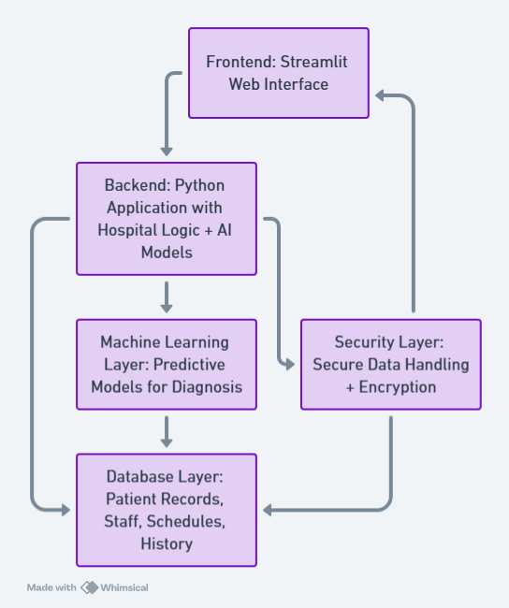
System Architecture
Frontend: Interactive and responsive web interface developed with Streamlit.
Backend: Python-based backend integrating hospital management logic and predictive AI models.
Database Layer: Centralized management of patient records, staff details, operational schedules, and historical data.
Machine Learning Layer: Robust predictive models trained on comprehensive datasets, capable of instant diagnoses.
Security Layer: Implements secure data handling and encryption to ensure patient privacy.

Slide 7
Live Demo of Project
Demonstration of hospital staff and patient record management.
Step-by-step showcase of operational scheduling and tracking.
Real-time disease prediction workflow:
User input for patient health data
Instant AI-driven results
Highlight intuitive navigation and minimalistic design enhancing user experience.

Slide 8
Video of Project Demo

Slide 9
Conclusion
Successfully developed an integrated healthcare management solution with AI predictive analytics.
Improved efficiency and accuracy in hospital operations, reducing administrative workload.
Facilitated early detection of chronic diseases, significantly boosting patient health outcomes.
Demonstrated potential to transform healthcare delivery through technology and innovation.
Positioned the healthcare facility to provide superior patient care with a forward-thinking digital solution.

Slide 10
Future Scope
Extend predictive capabilities to cover additional diseases, creating a comprehensive health diagnostic tool.
Integration with IoT and wearable devices for continuous health monitoring and personalized care.
Development of mobile applications to enhance accessibility for healthcare providers and patients.
Implementation of a centralized health network connecting multiple hospitals for real-time data sharing and improved healthcare services.
Utilize predictive analytics for preventive healthcare measures and personalized medicine strategies.

Slide 11
Thank you!
Notes:
thank you very much for joining this PPT, keep learning.
11

